Slide 1
어떻게 하면 과학 글을 잘 쓸까?
“혼신의 글쓰기"

Slide 2
“혼신¹의 글쓰기"
‘연구자로, 비평가로
제가 매 순간 최선을 다해 성실했다면
그것이 사라져 없어진 것이 아니라, 어딘가에 남아서 힘이 되어
시방 저녁놀 빛, 몽매함에 (ignorance) 놓인 제게 되돌아오고 있지 않겠는가.
제가 그토록 갈망하는 표현자의 세계로 나아가게끔
힘이 되어 밀어주고 있지 않겠는가’
(김윤식, 「갈 수 있고, 가야 할 길, 가버린 길」)
영혼과 정신

Slide 3
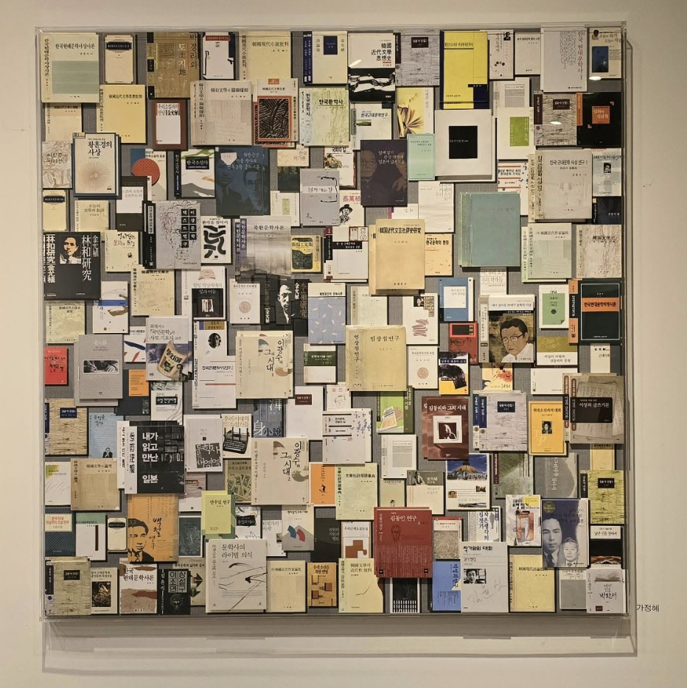
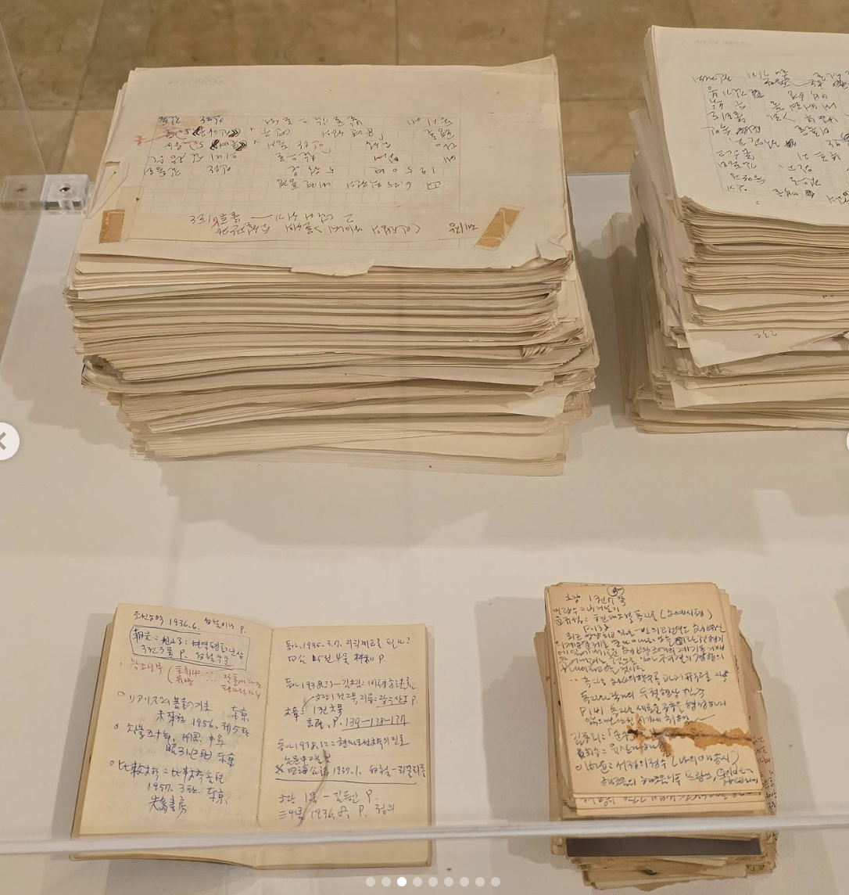
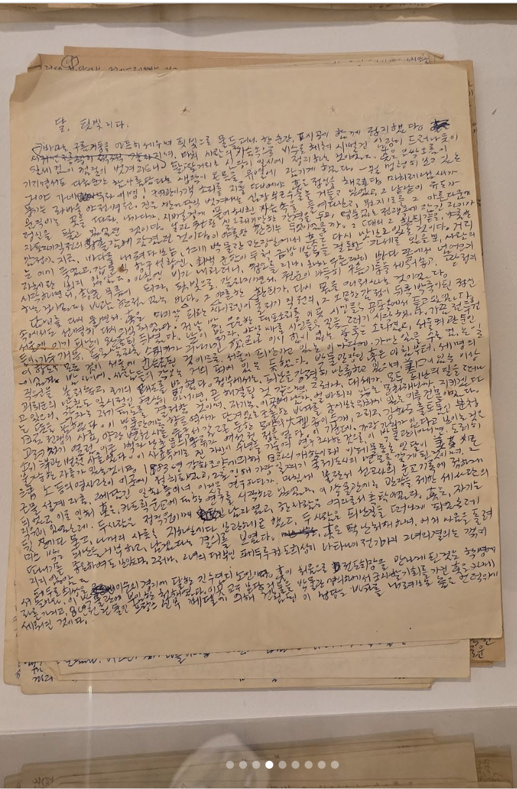
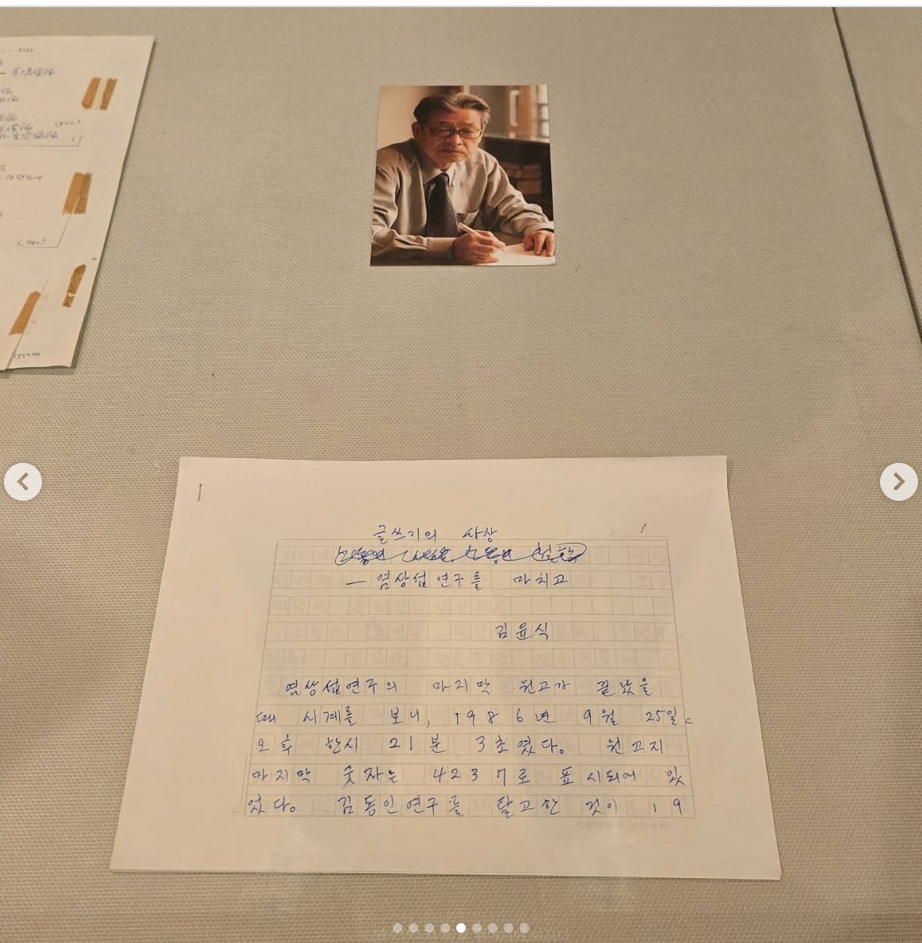


₩

Slide 4
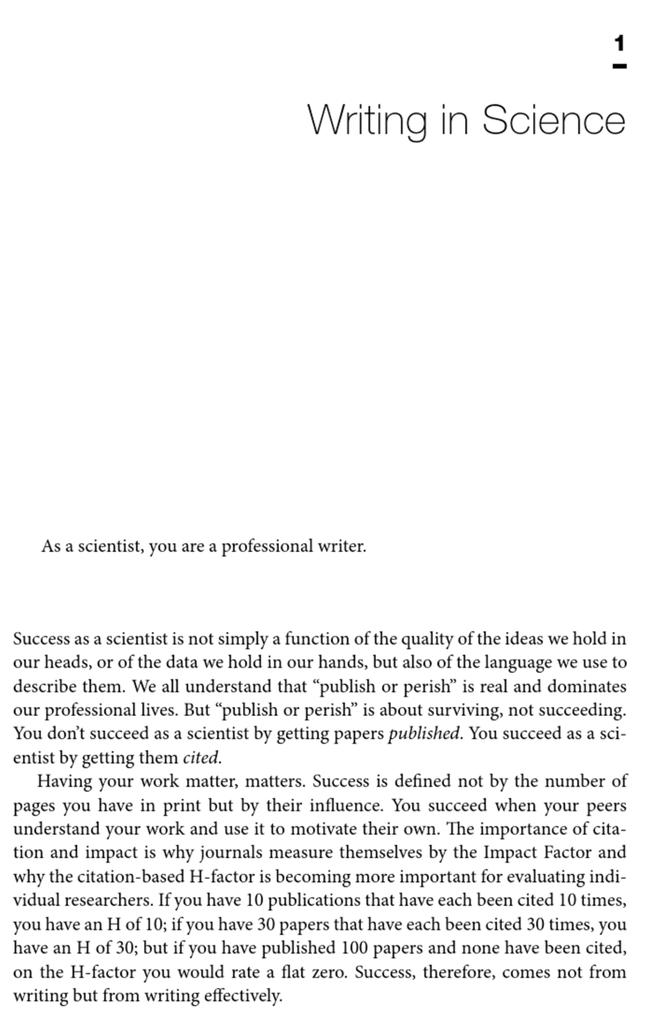
Writing science : how to write papers that get cited and proposals that get funded, by Joshua Schimel

Slide 5
Markus Meister
Watson and Crick
Klaas Stephan
Sonia Bishop
Jiook Cha

Slide 6
글잘쓰기 위해서 읽고 또 읽은 책
학생때, The elements of style, by William Strunk (링크)
포닥때, Writing science : how to write papers that get cited and proposals that get funded, by Joshua Schimel (링크).

Slide 7
글 잘쓰기 방법:
좋은 글 많이 읽기
쓰고자 하는 저널의 논문 많이 읽기.
읽은 것 중 가장 좋은 것 (e.g., 심장을 뛰게한 것) 반복해서 읽기.
논문 읽다가 좋은 글 취합해놓기 (서론, 결과, 논의, 방법 따로)
2. 글 많이 쓰기
글 잘쓰고 싶어하기 (자기글이 만족스럽지 않아야함)
하루에 한단락씩 쓰기.
오늘 배운거 정리해서 써보기
읽은 논문 소화해서 써보기
실험 디자인, 결과 써보기
계속해서 고쳐쓰기 (언제까지?)

Slide 8
논문 이렇게 읽어봅시다
Disclaimer. 필드에 따라 다를 수 있음. (저는 자연과학 트레이닝을 주로 받았음)
초록
연구의 의미는 문헌과 비교/합성을 통해서 드러나는데, 초록에는 그 정보들이 없어서 잘 모르는 경우 많음
잘 알고 있는 주제의 경우는 제외
Discussion 첫 단락
이 연구의 목적과 핵심 결과, 그 의의에 대해서 명확한 아이디어가 생겨야함 → 그래야 좋은 페이퍼.
핵심 연구 질문, 실험, 뭘했는지?
핵심 결과, 뭘봤는지?
의미: 이 결과가 문헌에서 어떤 역할을 하는지 → 이걸 정확하게 파악하고 날카롭게 이야기 해주어야, 독자들이 연구의 가치를 빨리 파악할 수 있음. “독자 중심 글쓰기"
기존 가설, 모델을 지지하되, 더 깊은, 정확한, subtle 해석을 가능하게 하는 새로운 결과 → 모델의 업데이트
기존 가설과 모델과 배치되는 새로운 결과: 새로운 해석 방향, 모델 제시 → 모델의 수정 (예시)
Competing models중 하나를 지지하고 다른 하나를 지지하지 않는 역할 → 모델의 선택
새로운 모델이 필요한 발견, 새로운 데이터 융합에 의한 분석
새롭고 혁신적 기술의 소개 및 적용
This is sort of thesis paragraph of the entire manuscript.
그림/데이터 확인
Figure legend도 중요함
인트로, methods 안보고 Figure 부터 봄 (no acronyms!!! → ACC’s ambiguity activation, 부정적인 감정, 불필요한 working memory 사용)
“독자 중심 글쓰기": 그림의 배치, 색 사용, acronym, level of detail 모두 “독자가 최소한의 노력과 시간으로 이해할수 있도록" “최대한 친절하면서도-간결하게"

Slide 9
Discussion examples
This longitudinal study examined the fronto-accumbal pathway in AN using multimodal MRI. We found that within the fronto-accumbal pathway, underweight individuals with AN had increased structural connectivity, increased white matter anisotropy, increased functional connectivity, and altered effective connectivity (decreased OFC-to-NAcc excitation and increased recurrent OFC inhibition connections). The increased fronto-accumbal structural connectivity in the underweight state persisted following weight restoration and was associated with a measure of eating disorder severity. These findings suggest that hyperconnectivity in reward circuitry may be an important neural substrate in AN.
We found that aberrant IFG dynamics replicated results that we first identified for trait anxiety (Tolkunov et al., 2010) in both clinical anxiety and with anxious symptoms identified by the MASQ (suggesting an anxiety spectrum approach to be appropriate) and that this shift in functional dynamics was associated with altered functional and structural prefrontal-limbic connectivity within the circuit comprising the IFG, vmPFC, and amygdala. Specifically, IFG functional dynamics were strongly associated with bidirectional interactions with the vmPFC, whereas the vmPFC exhibited inhibitory causal influence upon the amygdala, a well-established excitatory node within the prefrontal-limbic network (LeDoux, 2003).
Here, we investigated the role of neuromodulatory midbrain and the broad corticolimbic system in threat-safety discrimination and whether abnormalities of this system are implicated in clinical anxiety. In healthy controls, the magnitude of activation in the VTA proportionally tracks the similarity of stimuli to CS, and mesocorticolimbic connectivity increases in response to CS. In individuals with GAD, however, the VTA is hyper-reactive to stimuli that resemble CS (i.e., GS) and mesocorticolimbic connectivity is significantly altered: increased in the ventral PFC and decreased in the hippocampus. These results suggest: (1) VTA activation and mesocortical connectivity are critical in threat processing; and (2) an abnormal mesocorticolimbic aversion system is implicated in the overgeneralization of conditioned fear in GAD.
Our 68-country survey challenges the idea that there is a widespread lack of public trust in scientists. In most countries, scientists and scientific methods are trusted. This finding is in line with other international studies on trust in scientists^{5,6,7}. Our study thus confirms, expands and strengthens previous work that refutes the narrative of a wide-ranging crisis of trust. We expand previous studies by providing a comprehensive dataset on trust in scientists post-pandemic and relying on a theoretically informed multidimensional trust measure. We also show that certain factors, such as being male, being conservative, having high SDO and having science-populist attitudes, are correlated with lower trust in scientists.

Slide 10
The elements of style, by William Strunk
Snu library; 좋은 책은 사서 보자.
I. Elementary Rules of Usage
1. Form the possessive singular of nouns by adding ’s.
2. In a series of three or more terms with a single conjunction, use a comma after each term except the last.
3. Enclose parenthetic expressions between commas.
4. Place a comma before a conjunction introducing an independent clause.
5. Do not join independent clauses with a comma.
6. Do not break sentences in two.
7. Use a colon after an independent clause to introduce a list of particulars, an appositive, an amplification, or an illustrative quotation.
8. Use a dash to set off an abrupt break or interruption and to announce a long appositive or summary.
9. The number of the subject determines the number of the verb.
10. Use the proper case of pronoun.
11. A participial phrase at the beginning of a sentence must refer to the grammatical subject.

Slide 11
II. Elementary Principles of Composition
12. Choose a suitable design and hold to it.
13. Make the paragraph the unit of composition.
14. Use the active voice.
15. Put statements in positive form.
16. Use definite, specific, concrete language.
17. Omit needless words.
18. Avoid a succession of loose sentences.
19. Express coordinate ideas in similar form.
20. Keep related words together.
21. In summaries, keep to one tense.
22. Place the emphatic words of a sentence at the end.

Slide 12
II. Elementary Principles of Composition
12. Choose a suitable design and hold to it.
13. Make the paragraph the unit of composition.
14. Use the active voice.
15. Put statements in positive form.
16. Use definite, specific, concrete language.
17. Omit needless words.
18. Avoid a succession of loose sentences.
19. Express coordinate ideas in similar form.
20. Keep related words together.
21. In summaries, keep to one tense.
22. Place the emphatic words of a sentence at the end.
독자 중심 글쓰기
“독자가 가장 쉽게/빨리 (가장 적은 뇌 힘으로)
화자의 의도를 최대한 잘/많이 이해하는 글”.

Slide 13
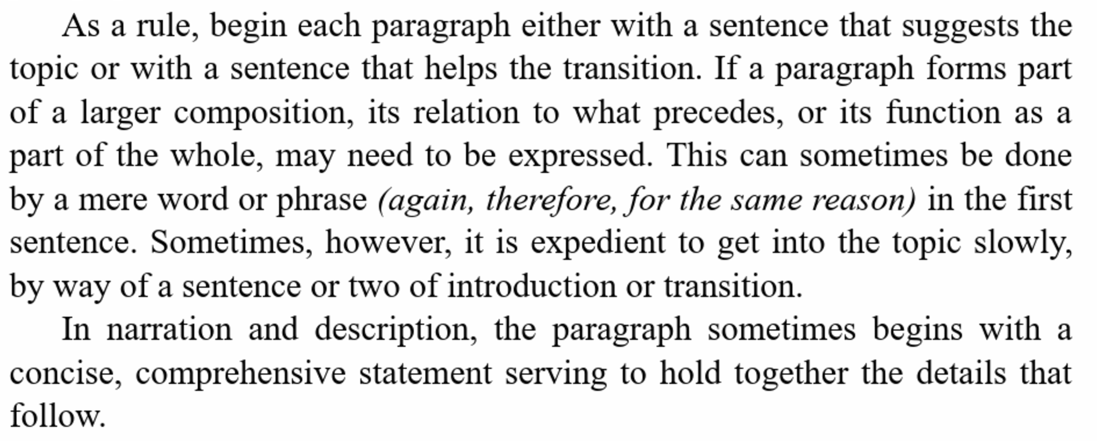
13. Make the paragraph the unit of composition.

Slide 14
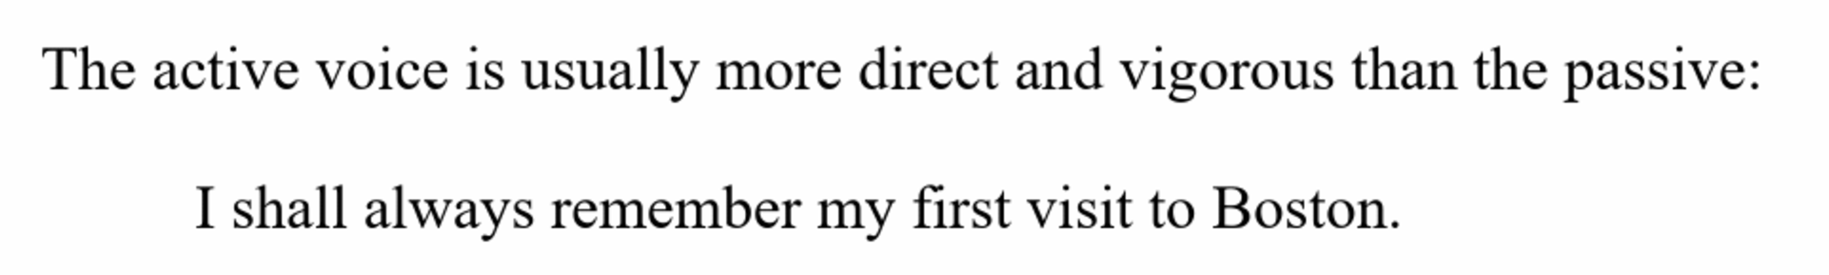
14. Use the active voice.

Slide 15
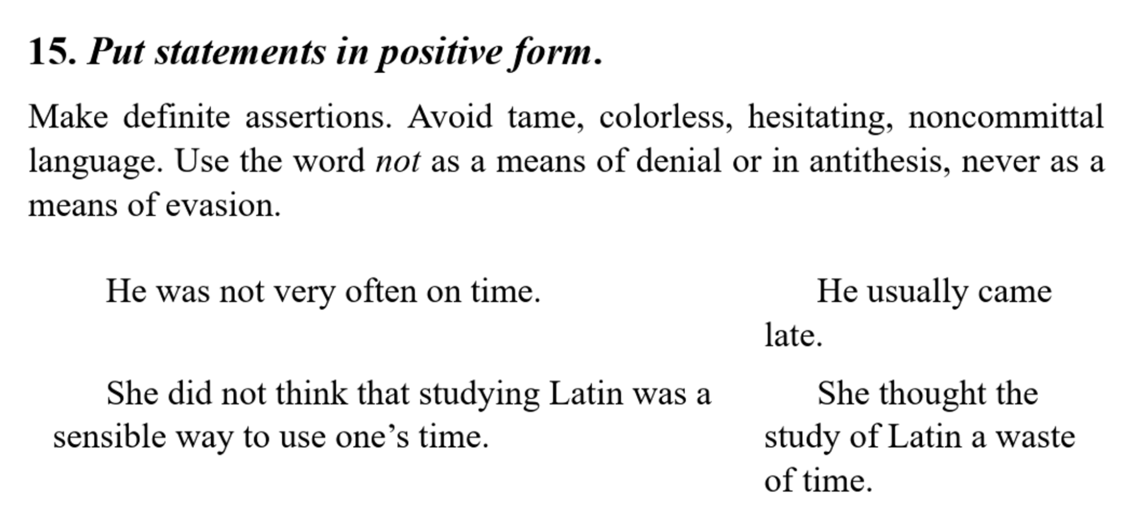

Slide 16
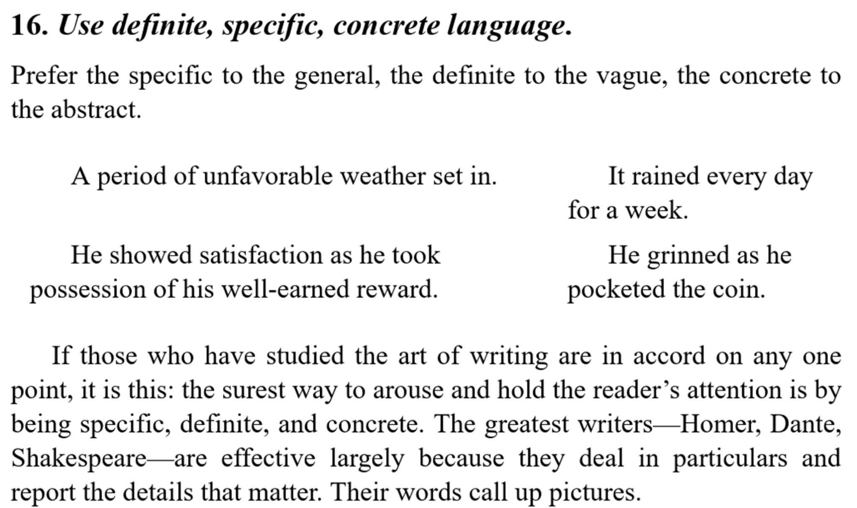

Slide 17
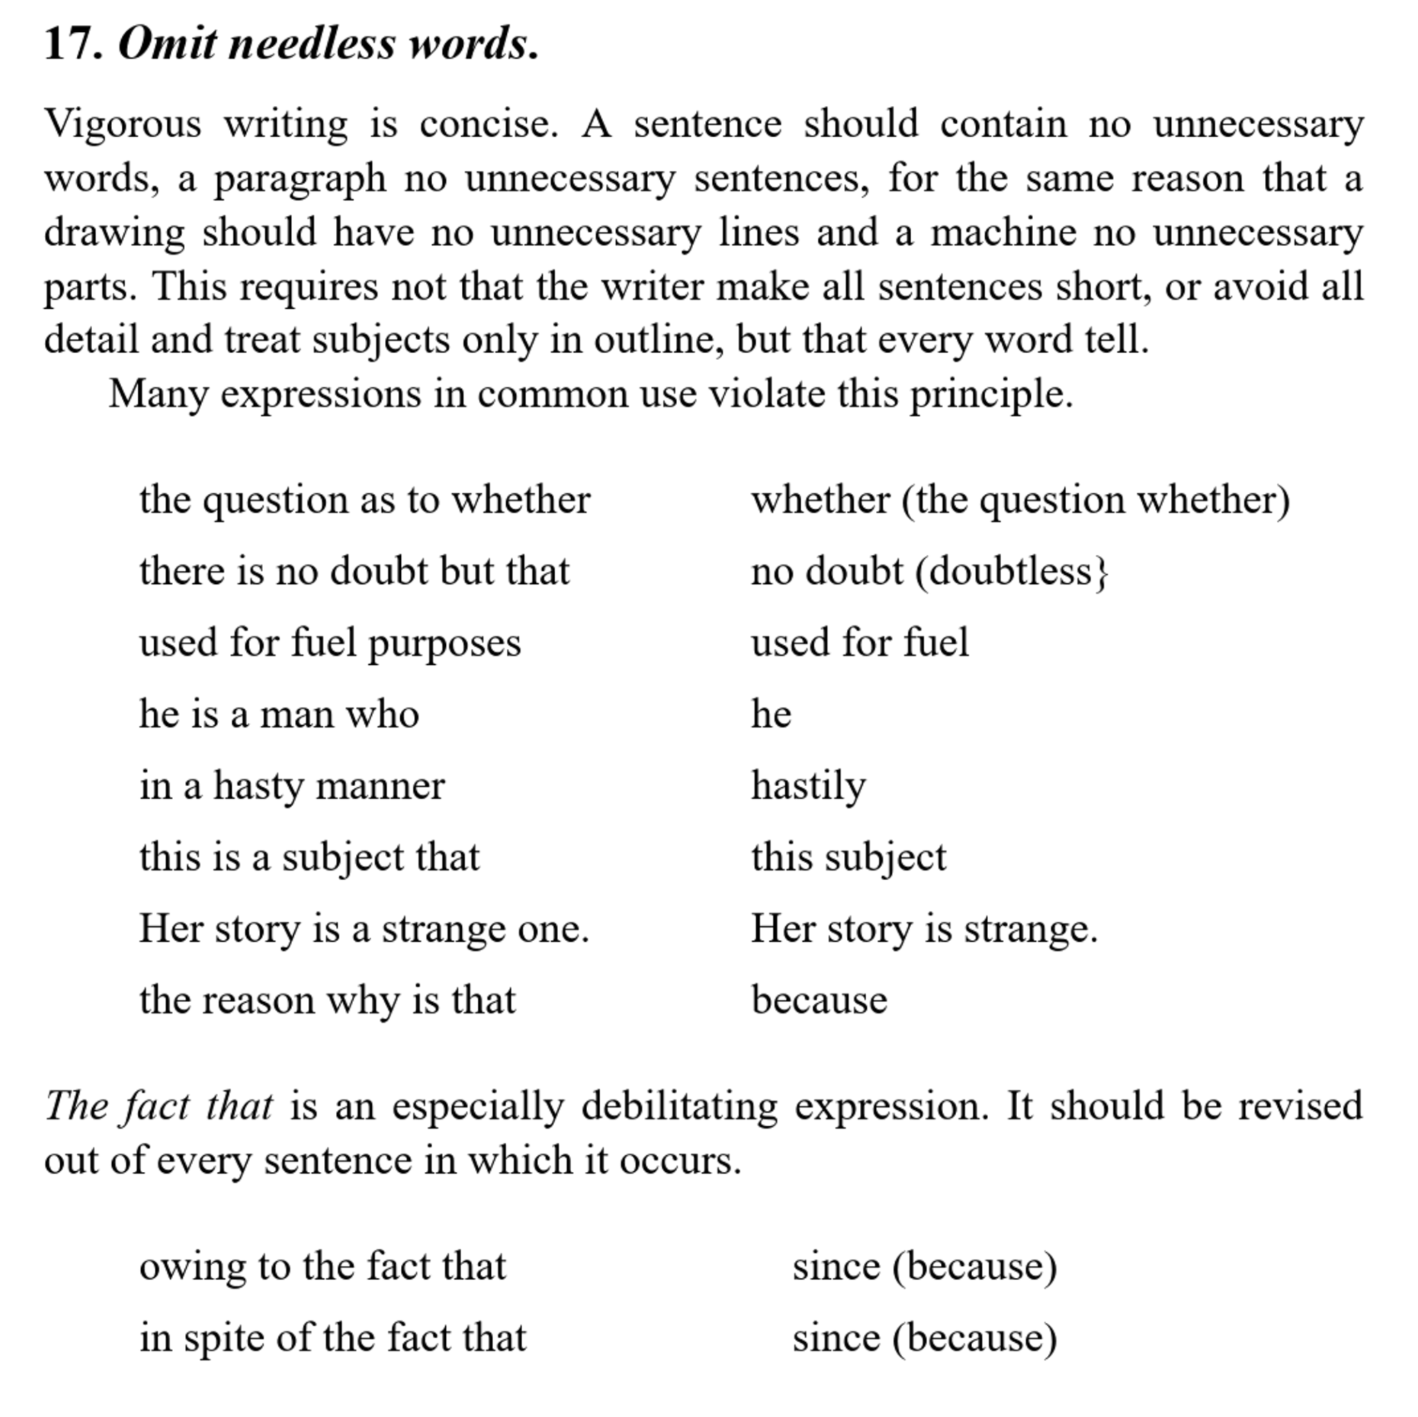

Slide 18
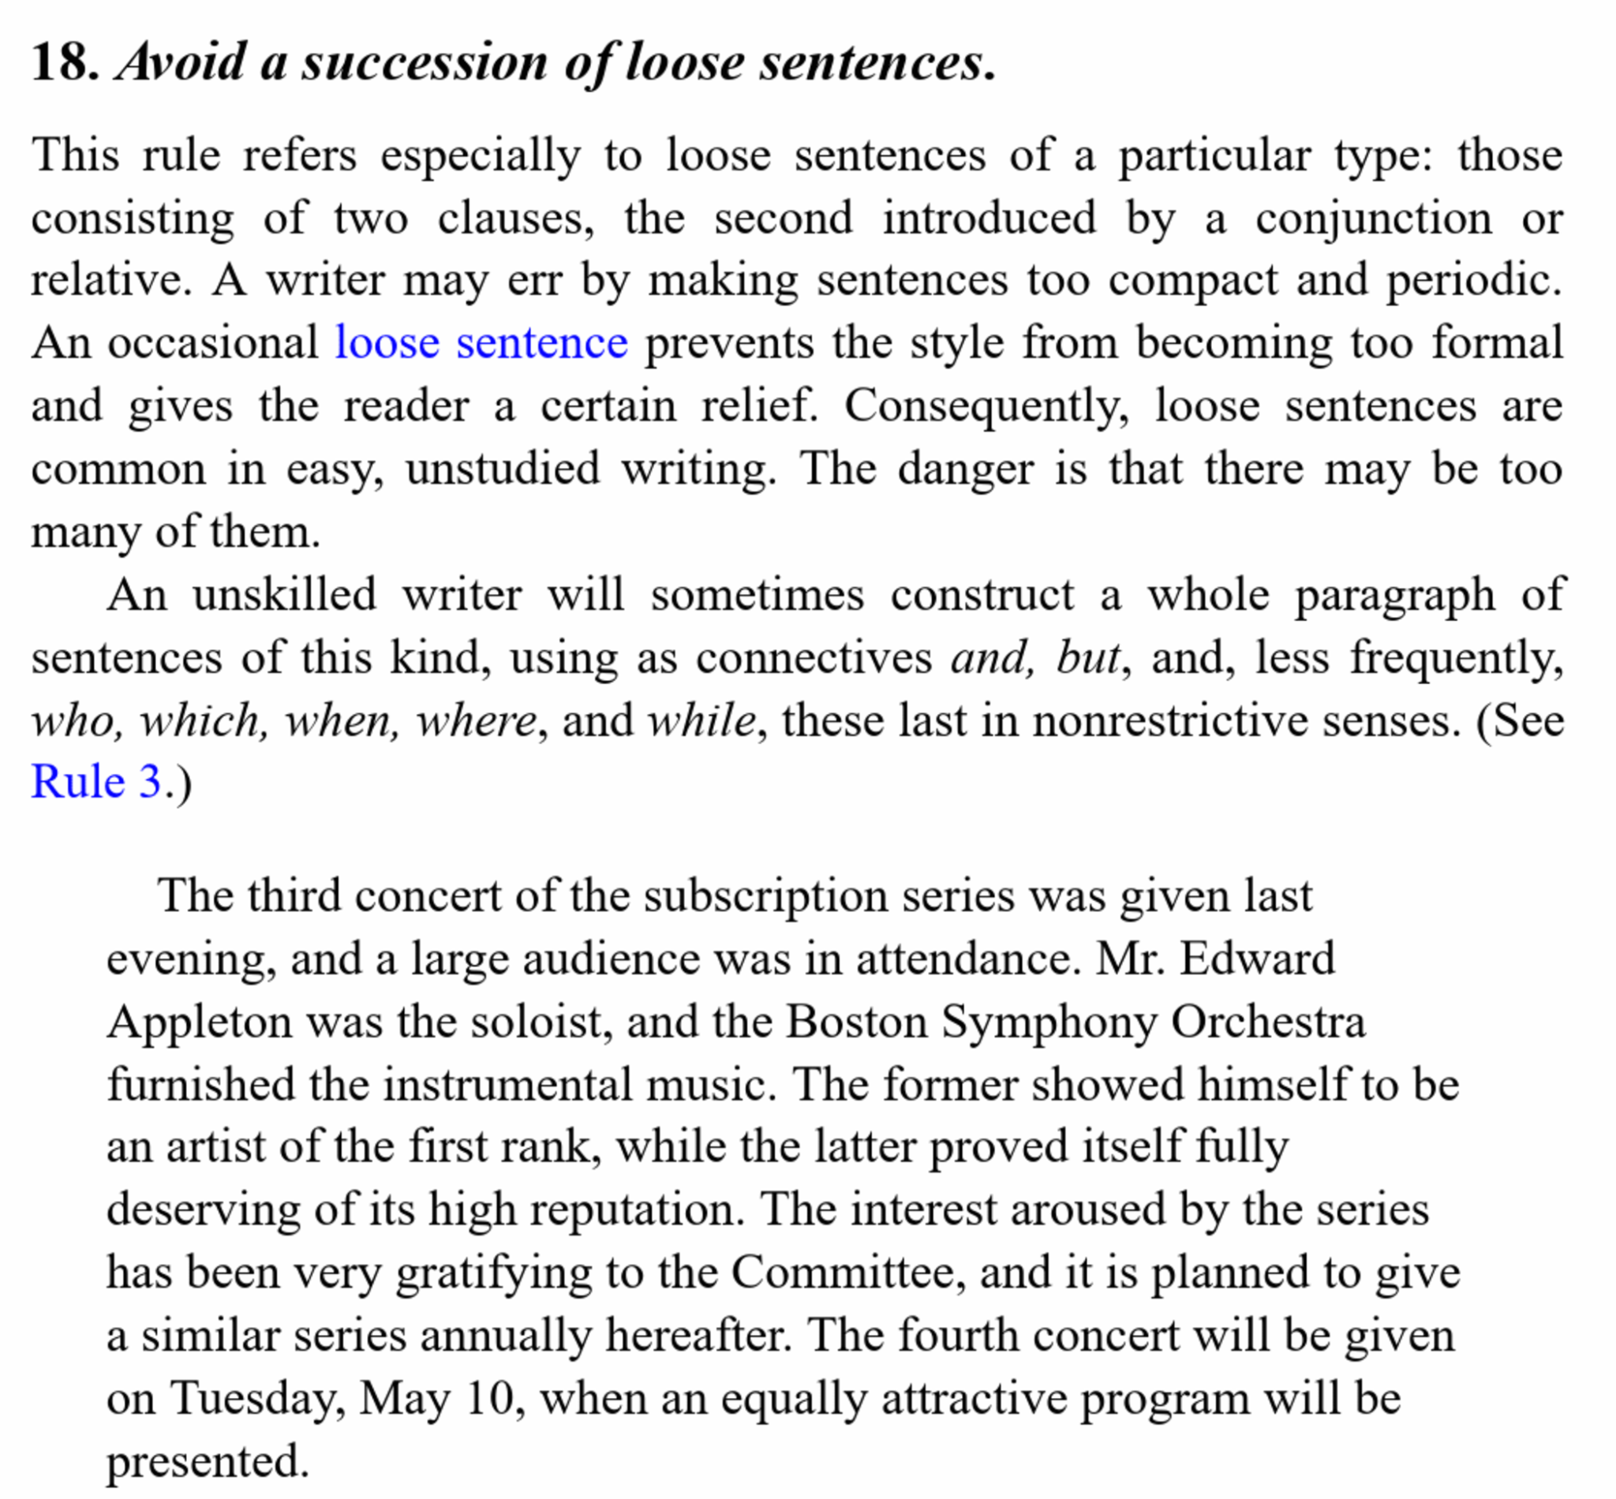

Slide 19
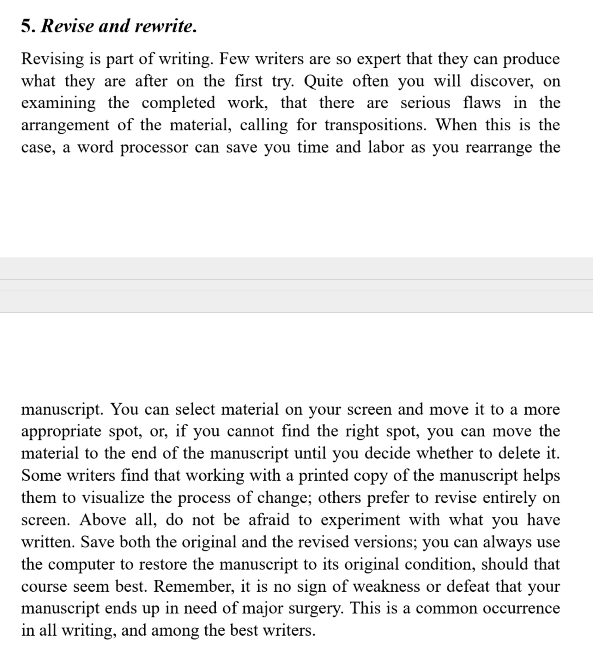

Slide 20
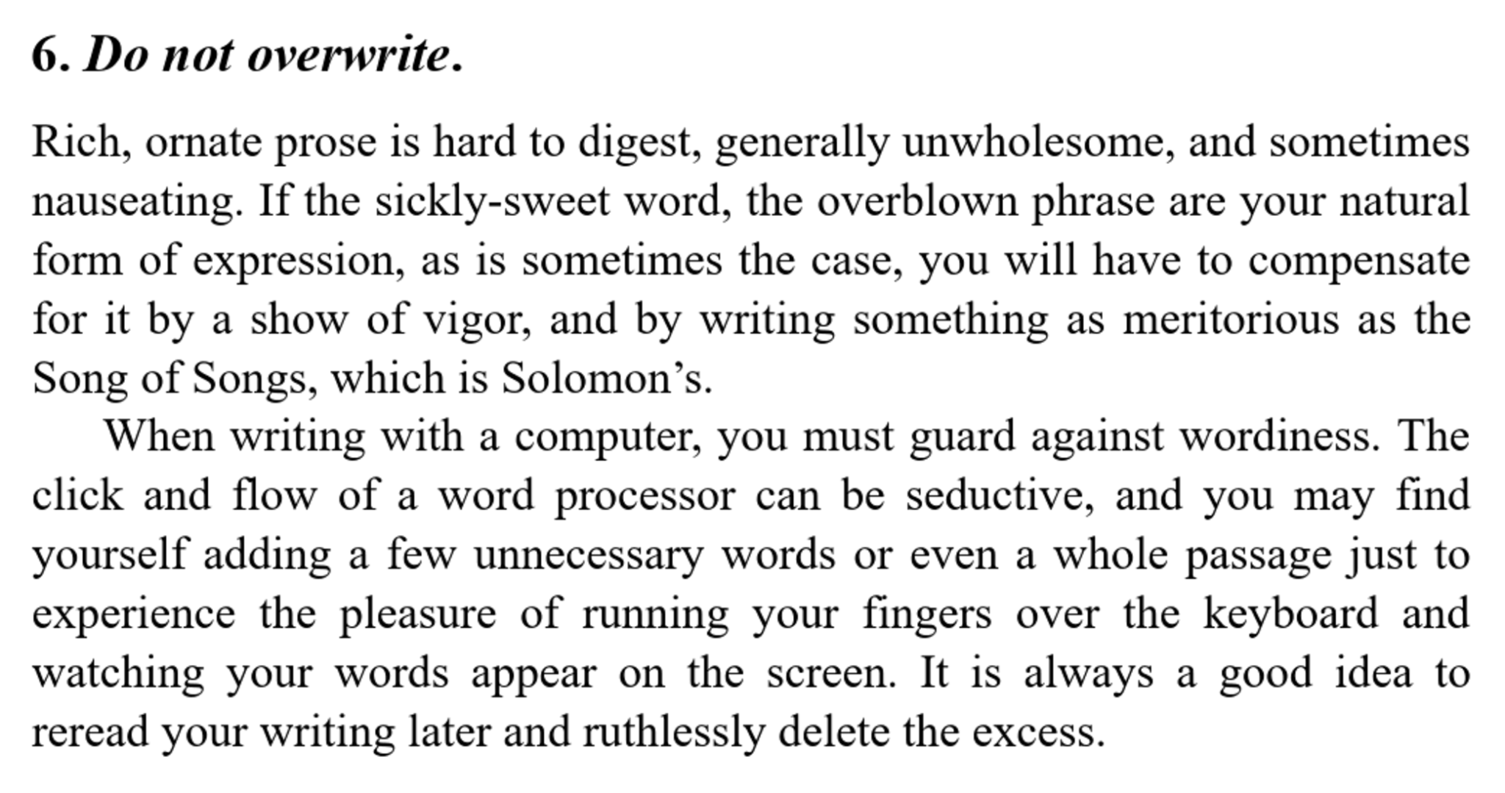
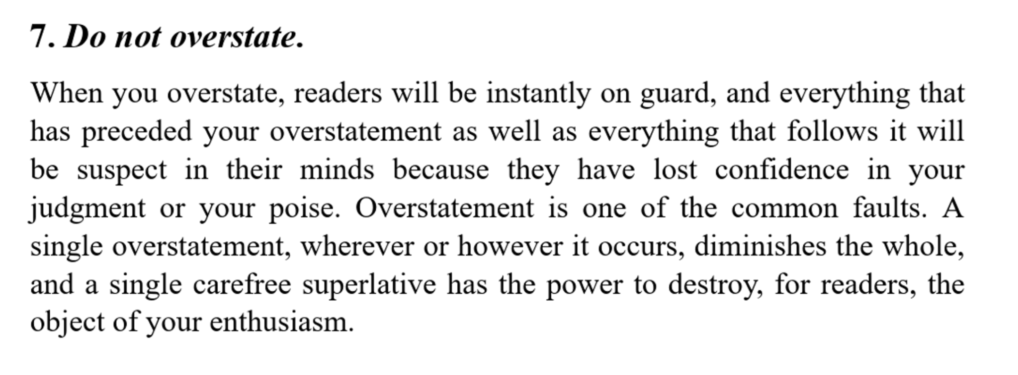
“인류역사 천년을 바꾼 논문도 이렇게 담백하게 썼는데
Proposal of double stranded DNA structure: https://www.nature.com/articles/171737a0
AlphaFold: https://www.nature.com/articles/s41586-021-03819-2

Slide 21
왓슨과 크릭의 DNA 페이퍼
Molecular Structure of Nucleic Acids: A Structure for Deoxyribose Nucleic Acid
WE wish to suggest a structure for the salt of deoxyribose nucleic acid (D.N.A.). This structure has novel features which are of considerable biological interest.
A structure for nucleic acid has already been proposed by Pauling and Corey1. They kindly made their manuscript available to us in advance of publication. Their model consists of three intertwined chains, with the phosphates near the fibre axis, and the bases on the outside. In our opinion, this structure is unsatisfactory for two reasons : (1) We believe that the material which gives the X-ray diagrams is the salt, not the free acid. Without the acidic hydrogen atoms it is not clear what forces would hold the structure together, especially as the negatively charged phosphates near the axis will repel each other. (2) Some of the van der Waals distances appear to be too small.
Another three -chain structure has also been suggested by Fraser (in the press). In his model the phosphates are on the outside and the bases on the inside, linked together by hydrogen bonds. This structure as described is rather ill-defined, and for this reason we shall not comment on it.
We wish to put forward a radically different structure for the salt of deoxyribose nucleic acid. This structure has two helical chains each coiled round the same axis (see diagram). We have made the usual chemical assumptions, namely, that each chain consists of phosphate di-ester groups joining p-D-deoxy-ribofuranose residues with 3 ',5' linkages….

Slide 22
알파폴드 페이퍼
The development of computational methods to predict three-dimensional (3D) protein structures from the protein sequence has proceeded along two complementary paths that focus on either the physical interactions or the evolutionary history. The physical interaction programme heavily integrates our understanding of molecular driving forces into either thermodynamic or kinetic simulation of protein physics16 or statistical approximations thereof17. Although theoretically very appealing, this approach has proved highly challenging for even moderate-sized proteins due to the computational intractability of molecular simulation, the context dependence of protein stability and the difficulty of producing sufficiently accurate models of protein physics. The evolutionary programme has provided an alternative in recent years, in which the constraints on protein structure are derived from bioinformatics analysis of the evolutionary history of proteins, homology to solved structures18,19 and pairwise evolutionary correlations20,21,22,23,24. This bioinformatics approach has benefited greatly from the steady growth of experimental protein structures deposited in the Protein Data Bank (PDB)5, the explosion of genomic sequencing and the rapid development of deep learning techniques to interpret these correlations. Despite these advances, contemporary physical and evolutionary-history-based approaches produce predictions that are far short of experimental accuracy in the majority of cases in which a close homologue has not been solved experimentally and this has limited their utility for many biological applications.
In this study, we develop the first, to our knowledge, computational approach capable of predicting protein structures to near experimental accuracy in a majority of cases. The neural network AlphaFold that we developed was entered into the CASP14 assessment (May–July 2020; entered under the team name ‘AlphaFold2’ and a completely different model from our CASP13 AlphaFold system¹⁰). The CASP assessment is carried out biennially using recently solved structures that have not been deposited in the PDB or publicly disclosed so that it is a blind test for the participating methods, and has long served as the gold-standard assessment for the accuracy of structure prediction^{25,26}.

Slide 23
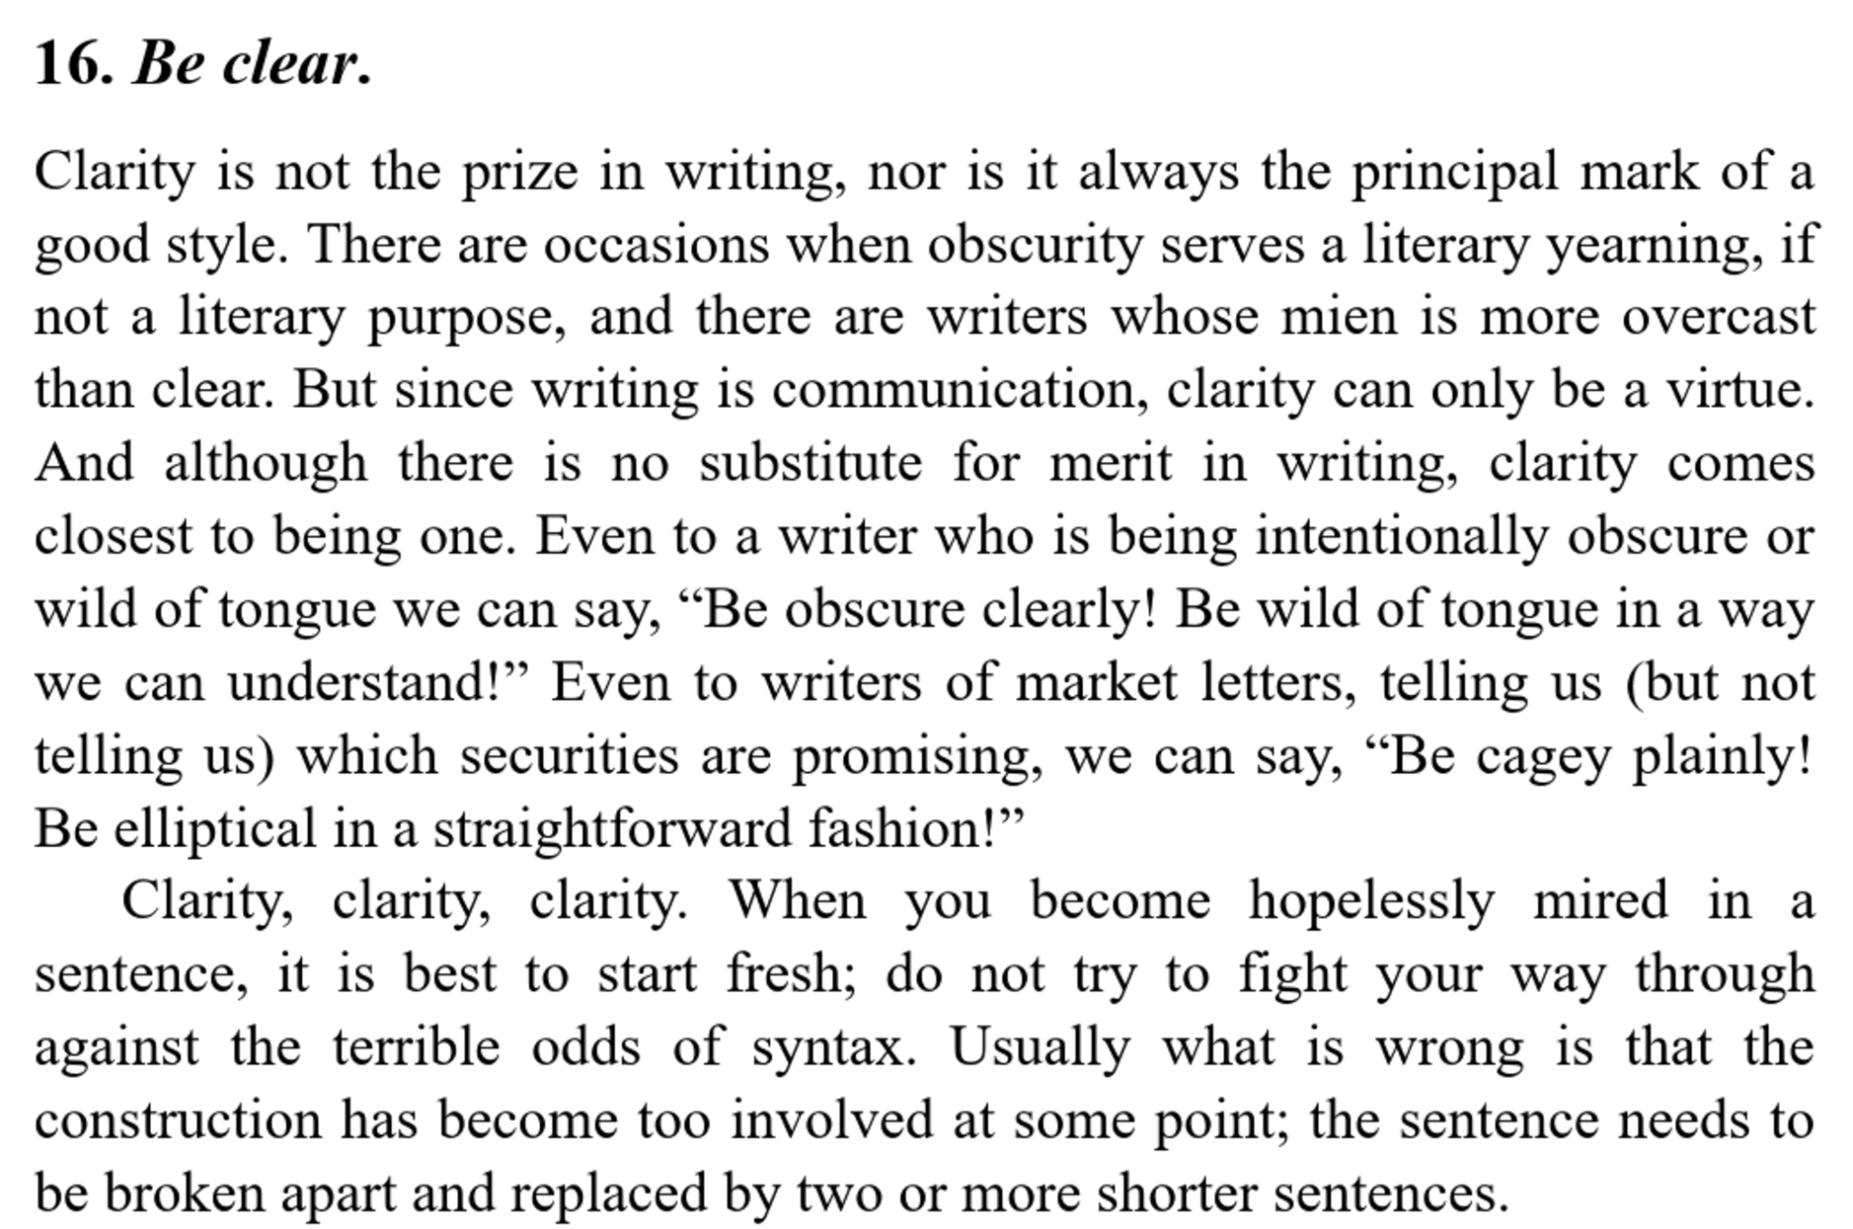

Slide 24
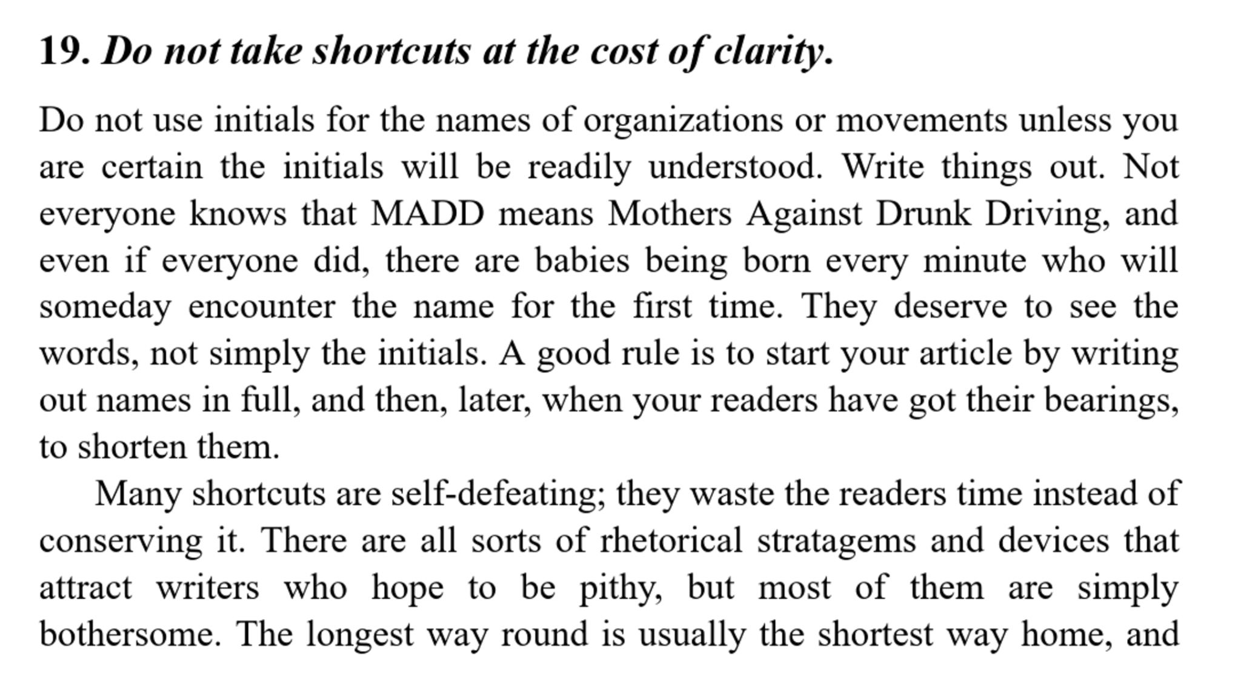

Slide 25


Slide 26
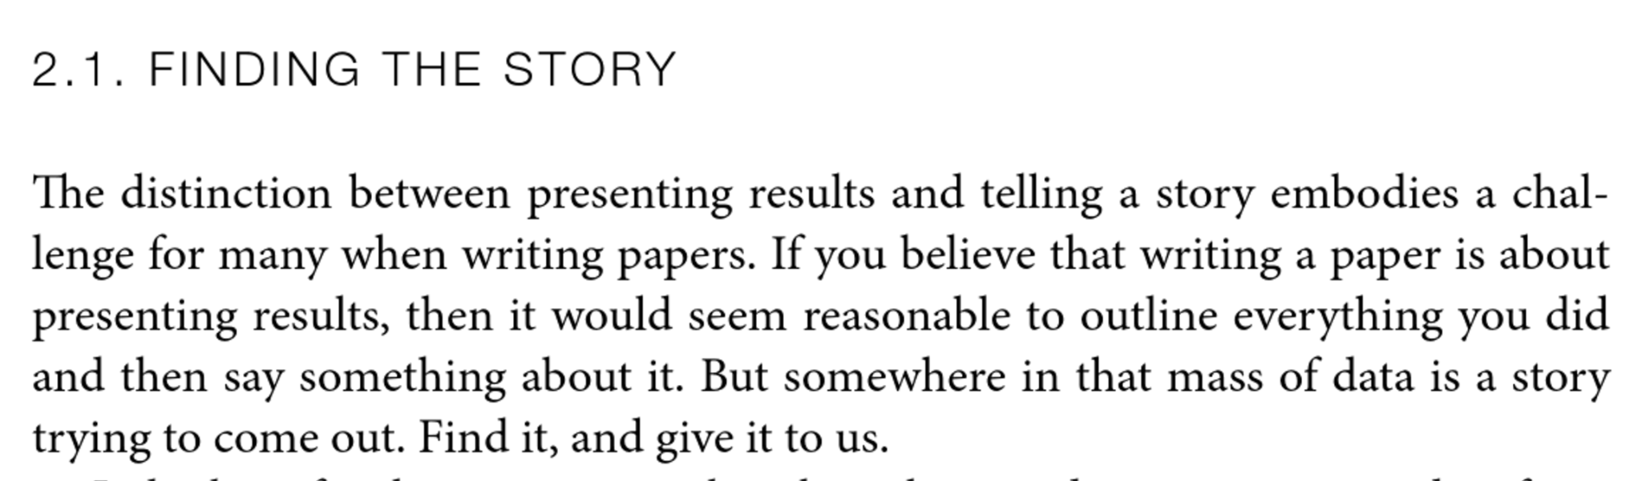
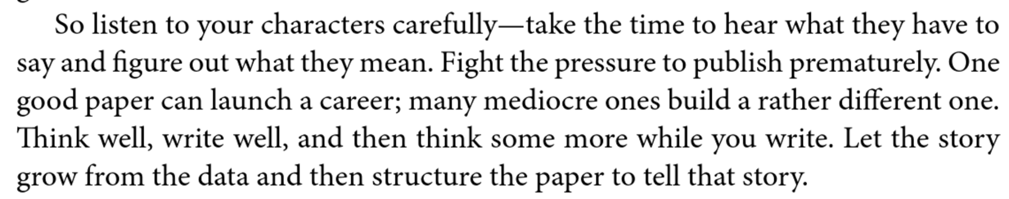

Slide 27

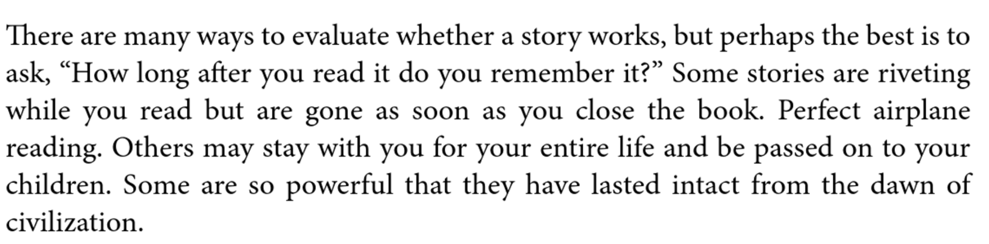
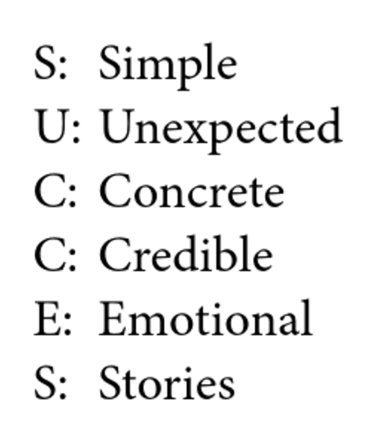

Slide 28
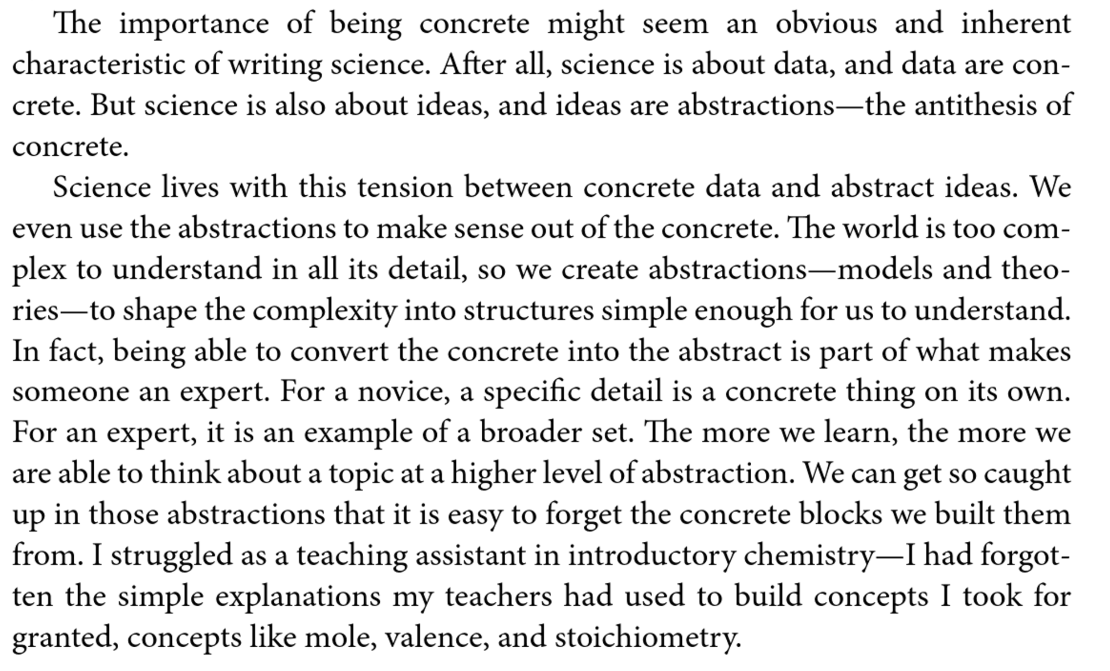

Slide 29
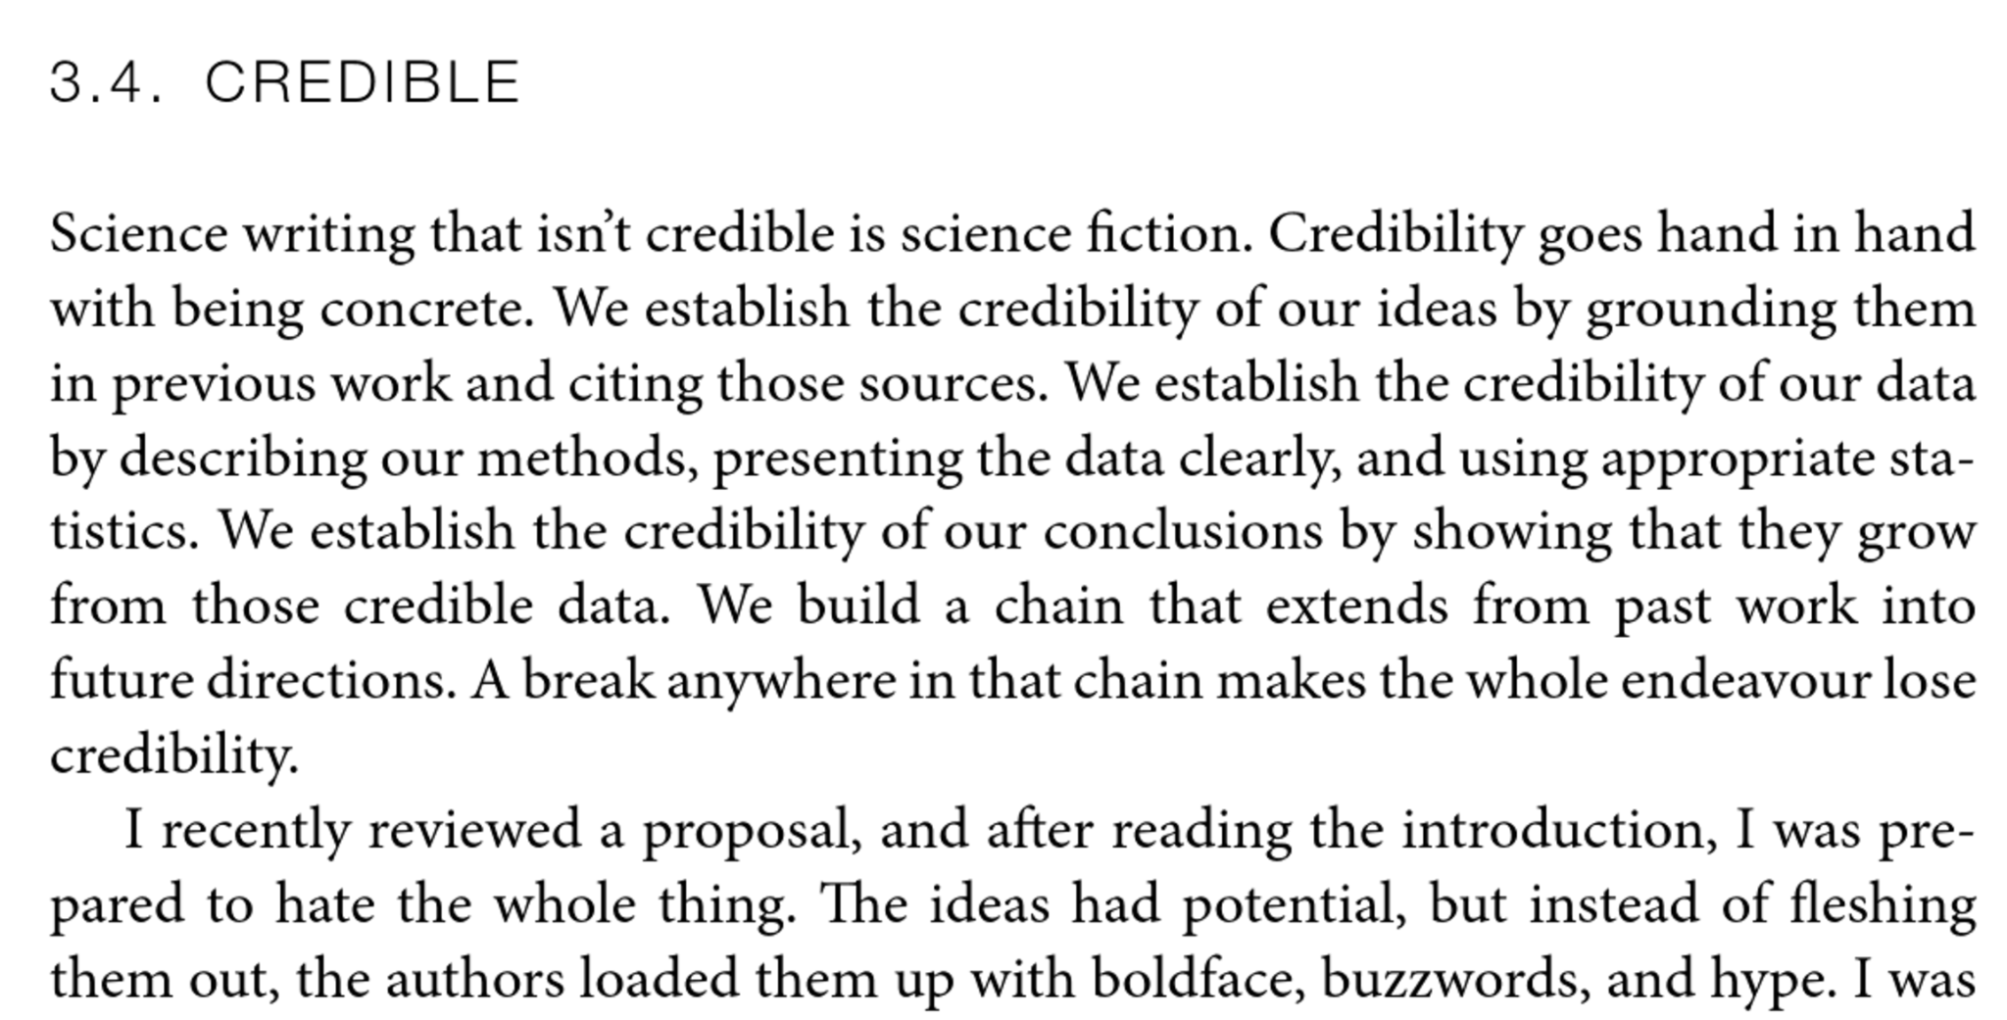
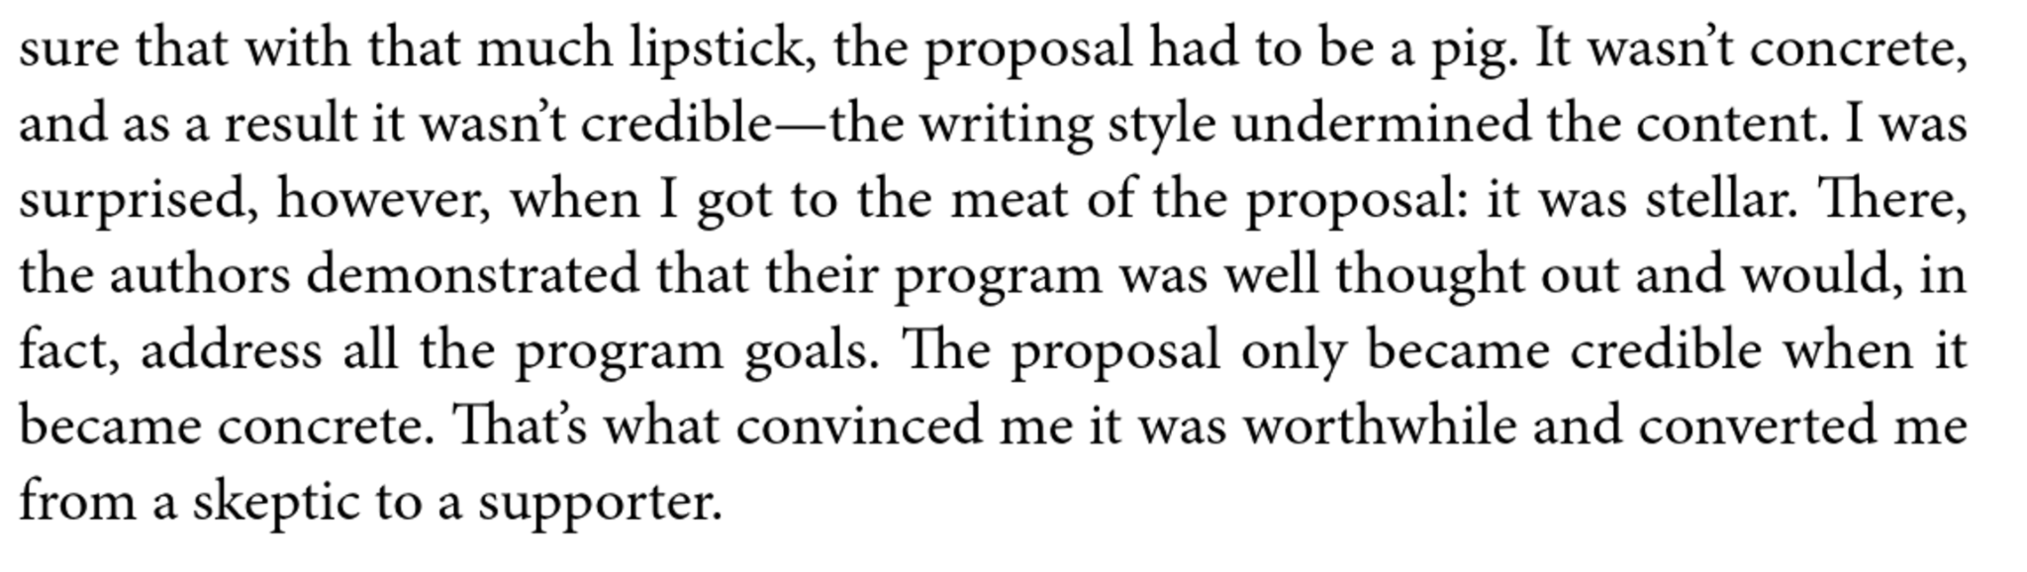

Slide 30
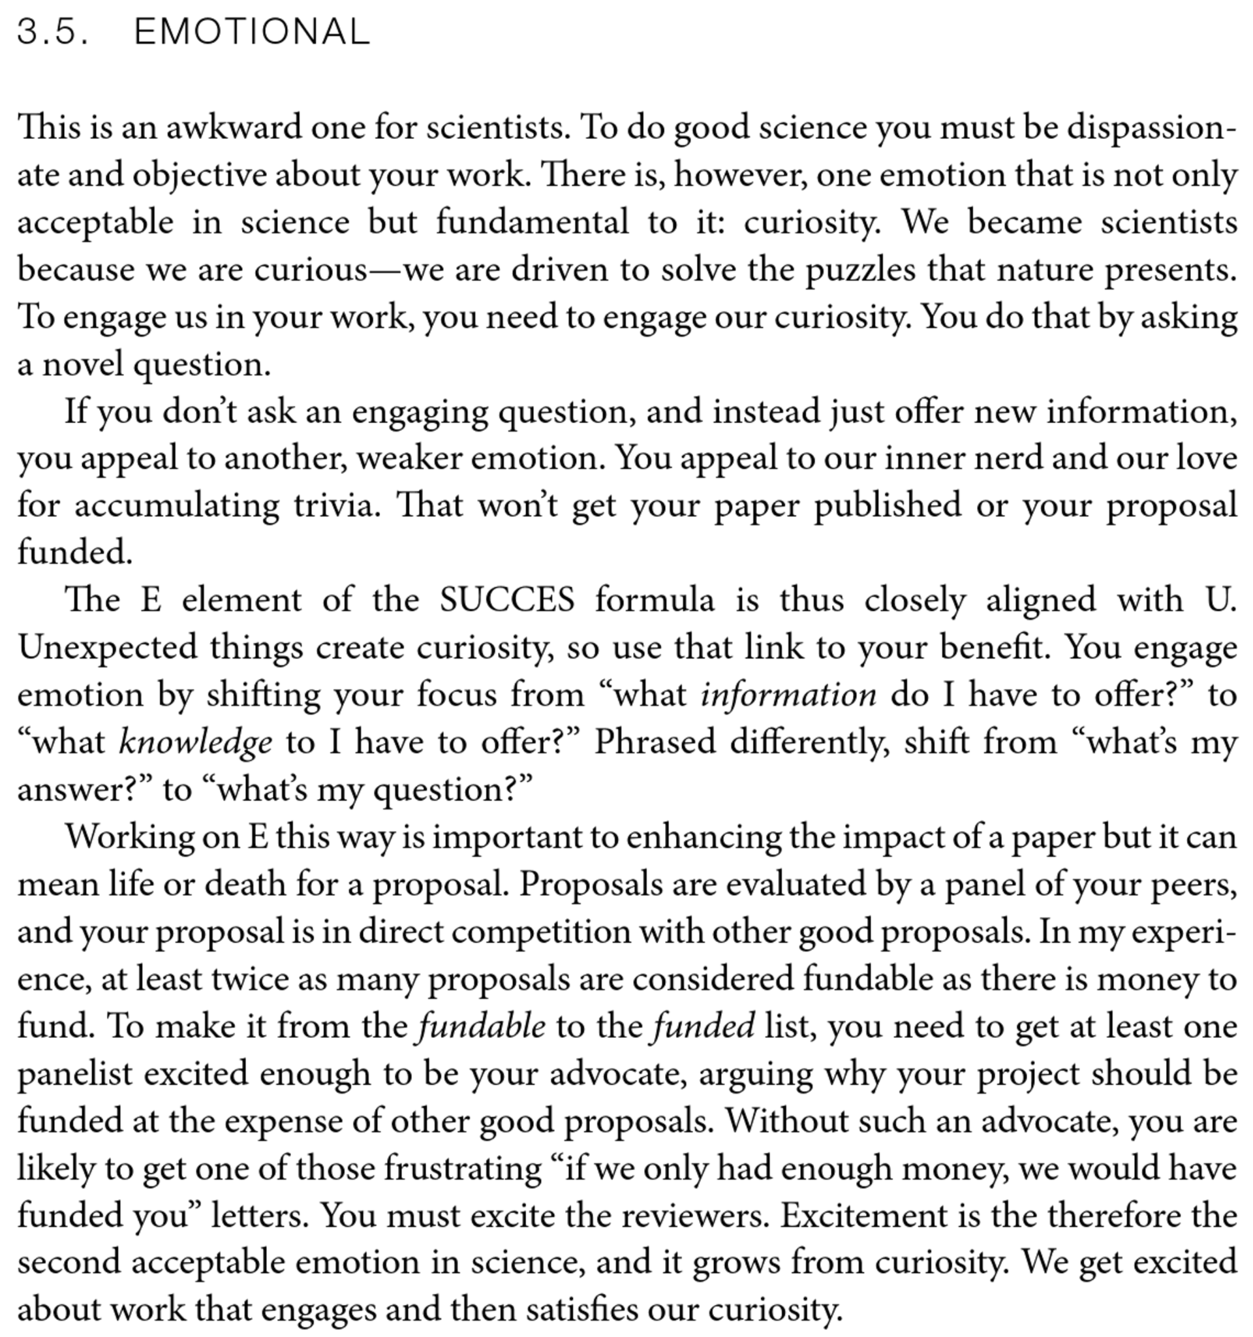

Slide 31
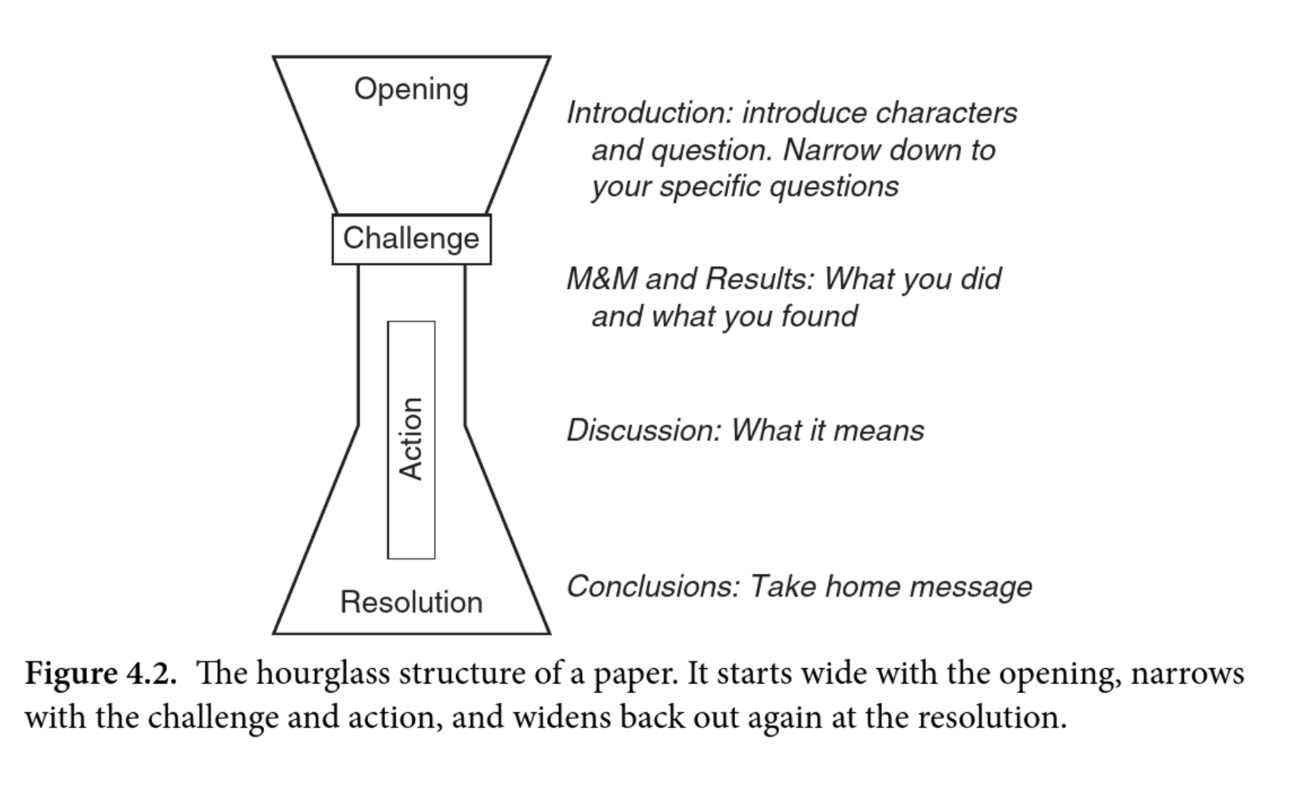

Slide 32

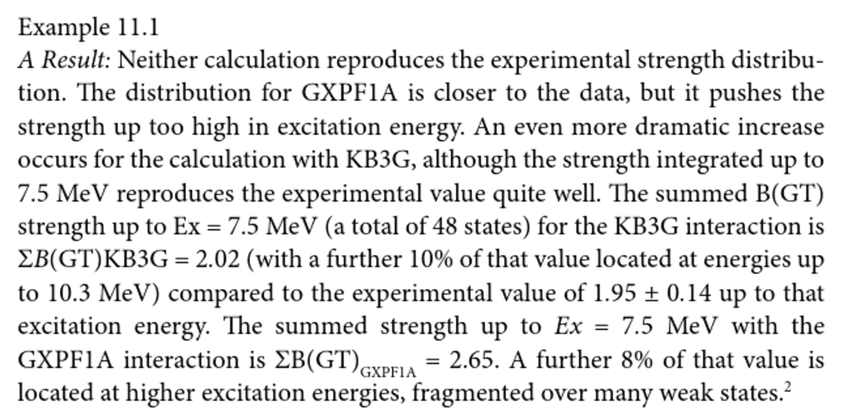
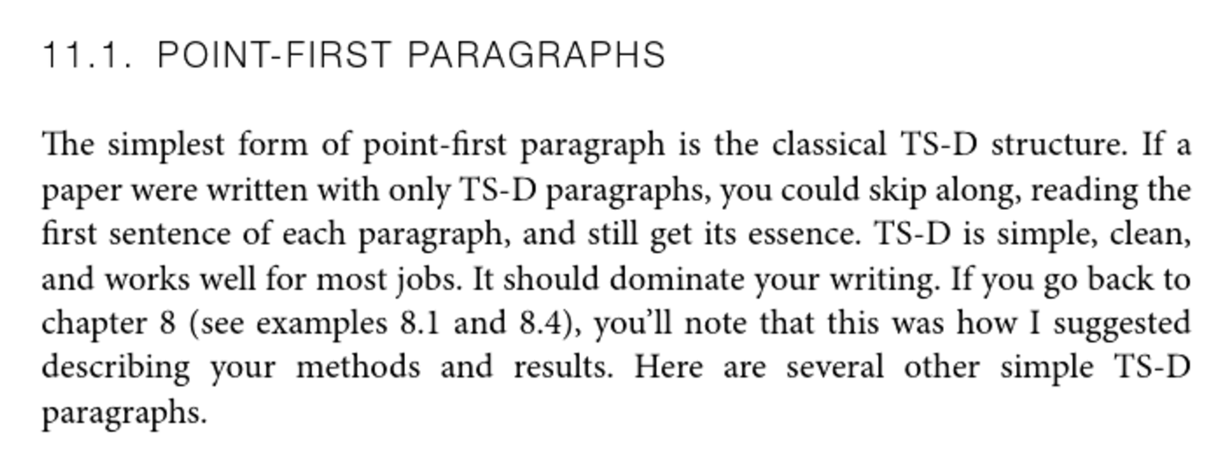
Topic Sentence-Development

Slide 33

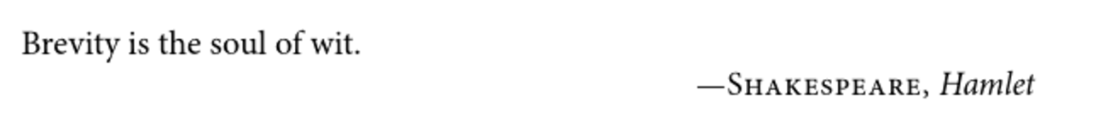
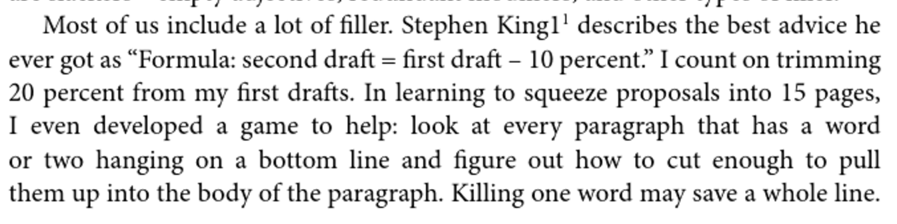
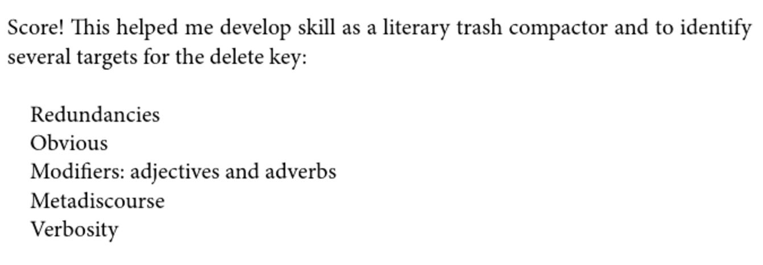

Slide 34
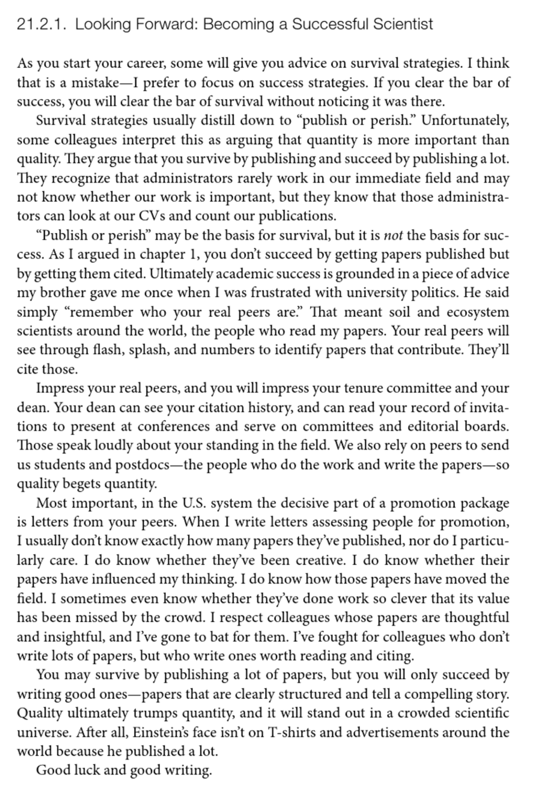

Slide 35
As a scientist, you are a professional writer

